Slide 1
Hyperledger, Overview (cont’d)
Source of most materials:
Xiwei Xu, Ingo Weber, and Mark Staples. Architecture for Blockchain Applications. Springer, 2019

Slide 2
What will you learn today?
Hyperledger
Functional properties of blockchains
Non-functional properties of blockchains

Slide 3
Hyperledger

Slide 4
Hyperledger Basics
Hyperledger is an umbrella project of open source blockchains and related tools
Global collaboration, hosted by the Linux Foundation since December 2015
Hundreds of members
Hyperledger Fabric is a business blockchain framework
Intended as a foundation for developing blockchain-based applications
Modular architecture
Configuration allows changing consensus algorithm
Private and permissioned blockchain
Smart contracts: chaincode
More information: https://hyperledger-fabric.readthedocs.io

Slide 5
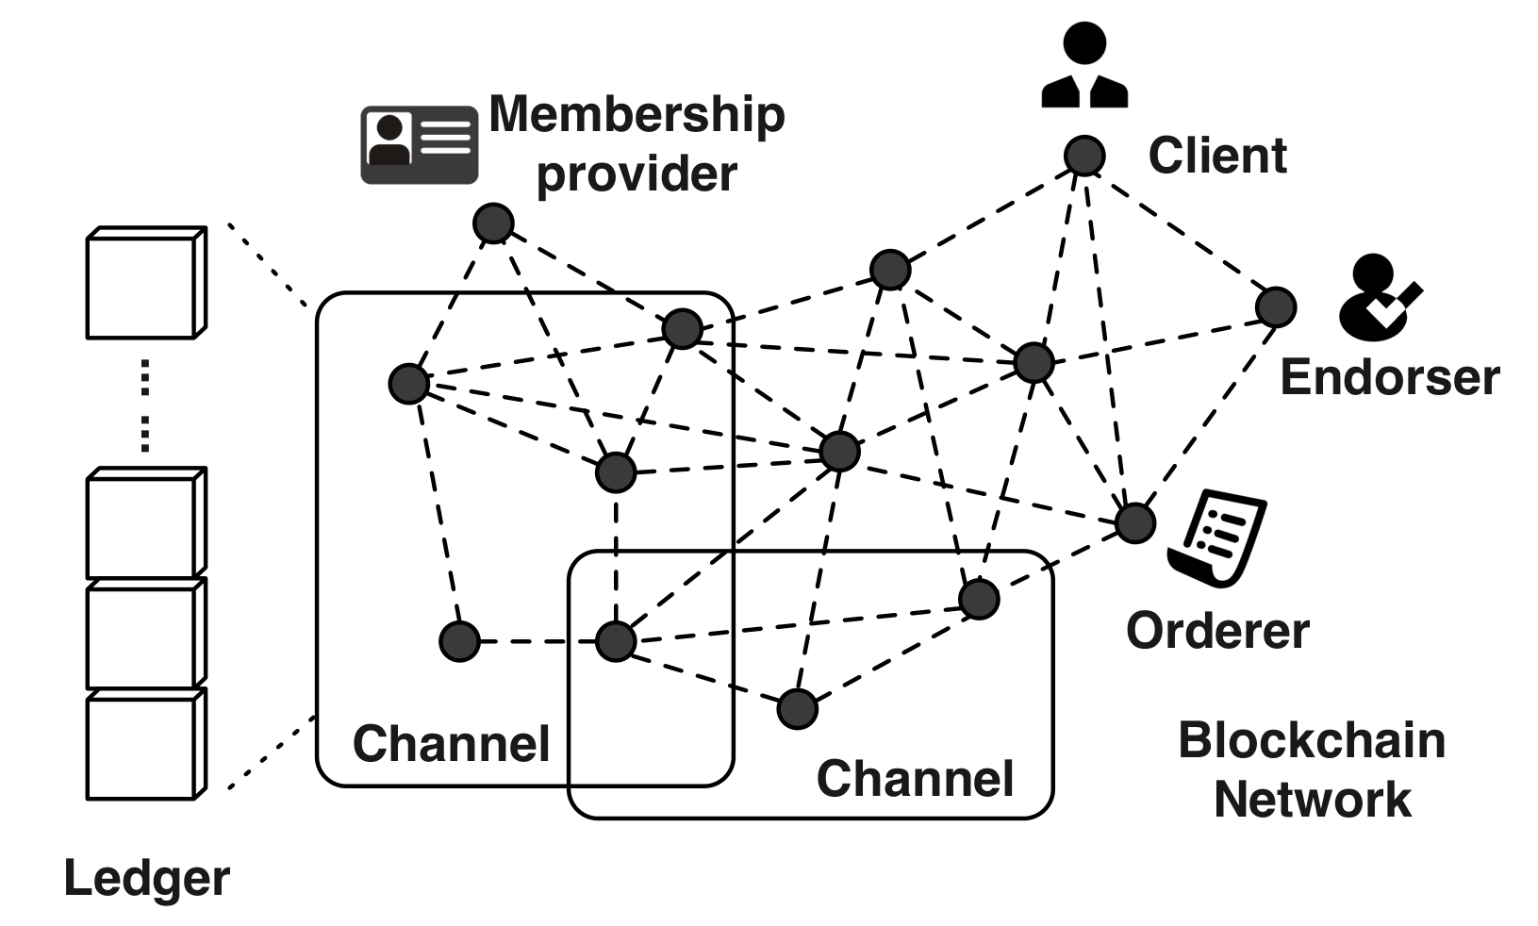
Hyperledger Fabric Overview
Membership service provider (MSP):
Members of a network need to enroll
MSP is trusted
All participants have known identities
Public keys are used as cryptographic certificates tied to organisations, network components and end users.
Channels:
Data access control is applied on the network and channel levels
Built for scenarios where privacy and confidentiality are important; reduced transparency is accepted
Channels allow a group of members to create a separate ledger, shared only with that group

Slide 6
Hyperledger Fabric Node Types
Three main types of nodes:
Client:
Acts on behalf of an end user; connects to peers to communicate with the blockchain
Can create and send transactions, and observe updates
Can connect to (multiple) channels, but is unaware of other channels
Peer:
Receives ordered transactions from the orderers, commits transactions, and maintains the state
Can play a special role: endorser
Every transaction invoking chaincode needs to be endorsed before being committed
Chaincode can specify an endorsement policy that defines the conditions for valid transactions
Orderer:
Validates and orders transactions into a sequence, then broadcasts them into the network
Implements communication channels between clients and peers
The ordering service provided by the set of orderers supports multiple channels, similar to “topics” in the publish/subscribe messaging pattern

Slide 7
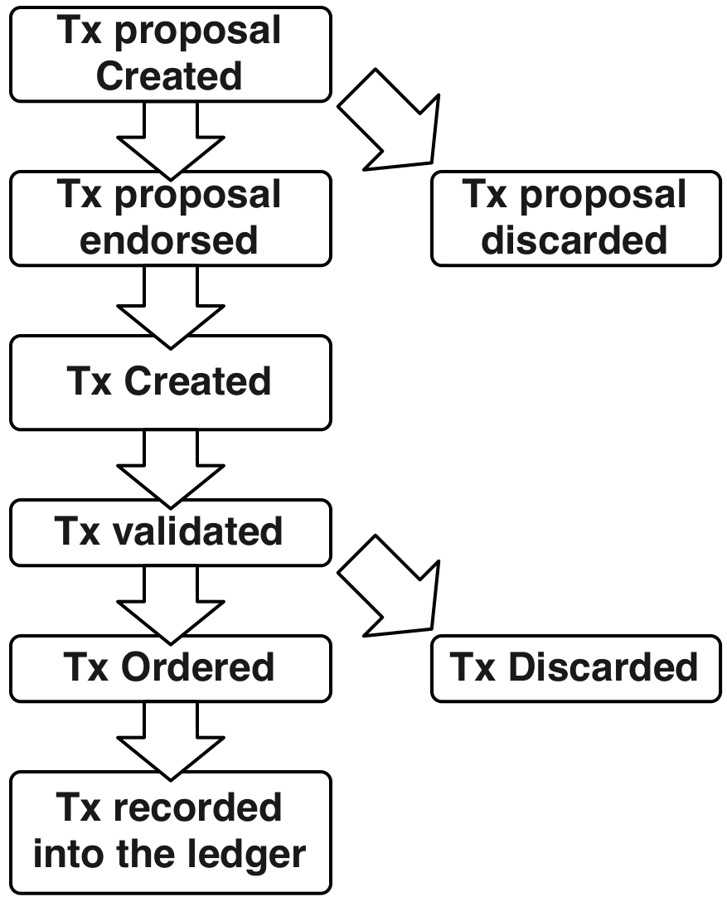
Hyperledger Fabric Transactions
Transaction proposal is created by an application client, and sent to endorsers
Endorsers verify signature and execute chaincode functions
Results and endorsements (signatures) are sent back to the client
Client sends endorsed transaction to an orderer
Orderer is responsible for transaction validation, ordering transactions into blocks, and delivering blocks to all peers on the channel
Peers receive transaction, check the endorsement policy, and authenticate the signatures
Peers also ensure data integrity of the transaction through checking that the data that was read during chaincode execution has not been changed since, and the execution result is still valid and can be committed
Otherwise, transaction is marked invalid

Slide 8



Student Task
Review the Hyperledger Fabric Tx lifecycle. What could go wrong?

Slide 9
Student Task
What kinds of applications of blockchain might be possible with a system based on Hyperledger Fabric that aren’t possible with (public) Ethereum?

Slide 10

Hyperledger Fabric Marketing Video
https://www.youtube.com/watch?v=js3Zjxbo8TM Bear in mind: it is from 2017 and it is a marketing video

Slide 11
Blockchain Functionality

Slide 12
Functions Blockchain can provide in a dapp
Architectural Element
Storage Element
Computational Element
Communi-cation Mechanism
Asset Management and Control Mechanism
Blockchain as…

Slide 13
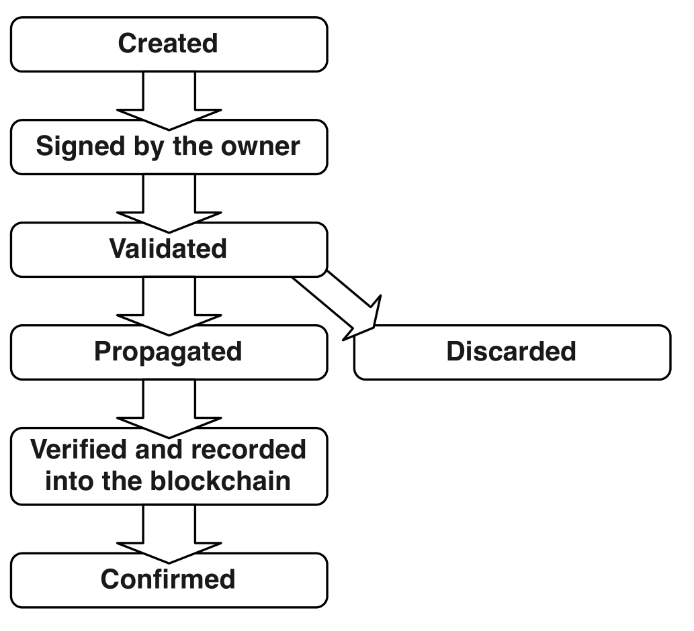
Blockchain Functionality
Blockchain as Storage Element
Append only data store – prevent tampering of data
An ordered list of blocks, where each block contains a (possibly empty) list of transactions.
Each block in is “chained” back to the previous block, by containing a hash of the previous block
Transactions
Information is recorded within the transactions
Update blockchain states
Store code, variables, and results of function call results
Public key and digital signatures are normally used to identify accounts and to ensure integrity and authorisation of transactions
Simplified Bitcoin Tx lifecycle
Notes:
Lifecycle of transactions
Created by an initiator
Signed with the initiator’s signature which provides authorization to spend the money, create a contract or pass the parameters
Sent to a node which validates the transaction
Invalid transactions are discarded
Valid transaction is propagated to other connected nodes for further validation and send it to their peers until it reaches every node (usually within a few seconds)
When it reaches a miner, it is verified and maybe included in a block
The network reaches a consensus about the latest block to be included into the blockchain using consensus mechanism
The new block is broadcasted to the network by the winning miner
The nodes receiving the new block, verify the block and record it into the blockchain
Users often wait a number of subsequent blocks to be added to the block containing a transaction before viewing the transaction as committed

Slide 14
Blockchain Functionality
Blockchain as a Computational Infrastructure
Smart contracts: programs, typically small in size, on the blockchain (e.g. escrow)
Architectural decision
Which parts of data and computation should be placed on-chain or kept off-chain since the amount computation power, data storage space and control of read accesses on a blockchain can be limited
A common practice: store hashed data, meta-data and small-sized public data on-chain and keep large and private data off-chain
There are existing platforms (e.g. IPFS) that can be used for providing a data layer on top of blockchain
Oracles: interacting with the external world
Notes:
40s
blockchain can be a software component offering computational capabilities.
Smart contracts allow us to execute small programs on the blockchain.
Smart contracts on Ethereum can express triggers, conditions and business logic, to enable complex programmable behaviours.
A common simple example of a smart contract-enabled service is escrow, Escrow can be implemented in a smart contract. It can hold funds until the conditions defined in the smart contract have been satisfied.
One of the main kinds of architectural decisions is about which pieces of functionality
should be allocated to which components.
For blockchain-based systems, this includes the key decisions about which parts of the data and computation should be placed on-chain or kept off-chain. Part of an application can be implemented inside the blockchain component using the blockchain ledger and smart contracts.
However the amount of computational power, data storage space, and control of read accesses on a blockchain can be limited.
So, parts of an application implemented outside the blockchain component might host off-line data and application
logic. Blockchain transactions and their effects sit at the interface between on-chain
and off-chain functions.
A common practice is to store hashed data, meta-data, and some small-sized
public data on-chain, and to keep large or private data off-chain. Due to the limited
size of the data store provided by the blockchain, an off-chain data store is necessary
for some applications. There are existing platforms providing a data layer on top of
the blockchains, such as Factom, which stores only the hash of the private data and
small amounts of public data in their own blockchain. Distributed data storage, like
IPFS8, or systems using DHTs (Distributed Hash Tables) are also sometime used in
combination with blockchains to build decentralized applications.
Blockchain computation has a closed-world assumption; smart contracts can usually
only examine state that is stored on the blockchain ledger. So in order to interact
with the external world, oracles are invoked to bring external state into the blockchain.
There are various sorts of oracles: some are like normal users of the blockchain,
and merely record facts about the world as normal transactions on the ledger;
while others are components or nodes within the blockchain platform that can invoke
smart contracts privileged to them. In either case, oracles typically become a
trusted party for this data about the external world.

Slide 15
Blockchain Functionality
Blockchain as a Communication Mechanism
Transactions that are announced get broadcast across the network
Committing a transaction to the data structure may be required before regarding the transaction as final
…or the receiver can already act based on the announcement
Blockchain as an Asset Management and Control Mechanism
Cryptocurrency and tokens are virtual assets
Typically, only the owner can control them
More complex models can be implemented, e.g.:
Multi-signature or threshold voting (more than one account controls an asset)
Escrow: smart contract code controls an asset
Very customizable through smart contracts

Slide 16
Student Task
Think of exam registration, and implementing it as a blockchain application
In breakout groups, take 5 minutes to think about how it could use blockchain functionality
Take notes
Then we’ll discuss

Slide 17
Blockchain Non-functional Properties

Slide 18
Blockchain Non-functional Properties
Immutability
If data is contained in a committed transaction, it will eventually become immutable
Non-repudiation
The immutable chain of cryptographically-signed historical transactions provides non-repudiation of the stored data
Integrity: cryptographic features (like hashes) support data integrity
Transparency: public access (on permission-less blockchains)
Equal rights
Allows every participant the same ability to access and manipulate the blockchain
Trust: Achieved from the interactions between nodes within the network
Censorship resistance
Notes:
Blockchain technologies may
provide advantages for immutability, non-repudiation, integrity, transparency, and
equal rights. If data is contained in a committed transaction, it will eventually become
in practice immutable. The immutable chain of cryptographically-signed historical
transactions provides non-repudiation of the stored data. Cryptographic tools
also support data integrity, the public access provides data transparency, and equal
rights allows every participant the same ability to access and manipulate the blockchain.
These rights can be weighted by the compute power or stake owned by the
miner.
Trust in the blockchain is achieved from the interactions between nodes within
the network. The participants of a blockchain network rely on the blockchain
network itself rather than relying on trusted third-party organisations to facilitate
transactions. These five properties (immutability, non-repudiation, integrity, transparency,
and equal rights) are the main properties supported in existing blockchains.

Slide 19
Blockchain Non-functional Properties
Limitations
Data privacy
No privileged users (on permission-less blockchains)
Tradeoff between data privacy and transparency
Scalability
Size of the data: limited due to the global replication of all data across the network
Transaction throughput: 3-40 transactions per second (tps) for Ethereum / Bitcoin
VISA network handles 1700 tps on average
By now, blockchain platforms with higher throughput (1000s tps) exist
Latency of data transmission
Write latency caused by propagation
Number of transactions included in each block (1MB for bitcoin)
Latency between submission and confirmation caused by consensus protocol
All addressed through various research and development
But there is no one-size-fits-all solution (yet?)
Notes:
3.30
Data privacy and scalability are two points of criticism of public blockchains. As
discussed earlier, in this setting privacy is limited: there are no privileged users, and
every participant can join the network to access all the information on blockchain
and validate new transactions. Often, applications need to find an acceptable tradeoff
between data privacy/confidentiality and transparency.
Current public blockchains have scalability limits on:
i the size of the data on blockchain, due to the global replication of all data across
all full nodes.
ii the transaction processing rate. For example, mainstream public blockchains
can only handle on average 3-20 transactions per second, whereas mainstream
payment services, like VISA, handles an average of 1,700 transactions per second10.
iii the latency of data transmission. Because nodes can have a local copy of the
blockchain, read latency can be good, but because updates must be propagated
across a global network, write latency is typically not good. The number of
transactions included in each block is also limited by the bandwidth of nodes
participating in leader election (for Bitcoin the current bandwidth per block
is 1MB). Latency between submission and confirmation that a transaction has
been included on a blockchain is affected by the consensus protocol. This is
around 1 hour (10-minute block interval with 6-block confirmation) on Bitcoin,
and around 3 minutes (14-second block interval with 12-block confirmation) on
Ethereum.

Slide 20
Decentralization
Deployment
Notes:
This table shows different types of deployment when using a blockchain. It includes public blockchain, consortium or community blockchain, and private blockchain.
Most digital currencies use public blockchains, which can be accessed by anyone on the Internet. Using a public blockchain can have better information transparency and auditability, but sacrifice performance and has a different cost model. In a public blockchain, data privacy relies on encryption or cryptographic hashes.
A consortium blockchain is typically used across multiple organisations. The consensus process in a consortium blockchain is controlled by pre-authorised nodes. The right to read the blockchain may be public or may be restricted to specific participants.
In a private blockchain network, write permissions are often kept within one organisation, although this may include multiple divisions of a single organisation.
Whether using a consortium blockchain, private blockchain or permissioned public blockchain, a permission management component will be required to authorise participants within the network. Private blockchains are the most flexible for configuration because the network is governed and hosted by a single organisation.
Many blockchain platforms support deployment as consortium blockchains or private blockchains, e.g., Multichain and Eris.

Slide 21
Decentralization
Permissions
A blockchain may be permissioned: having one or more authorities act as a gate for participation
Permission to join the network, to initiate transactions, to mine, to create an asset, etc.
Hyperledger Fabric is an example
Suitable in regulated industries; e.g. banks are required to establish real-world identity of transacting parties (“know your customer”, KYC)
Depends on the size of the network
Tradeoffs between permissioned and permission-less blockchain
Transaction processing rate, cost, flexibility, reversibility, etc.
Permission management mechanism may become a single point failure
Notes:
Instead of anonymous public participation, a blockchain may be permissioned in requiring
that one or more authorities act as a gate for participation. This may include
permission to join the network (and thus read information from the blockchain), permission
to initiate transactions, or permission to mine. Some permissioned blockchains,
e.g., Multichain, allow more fine-grained permissions, such as the permission
to create assets. Permissioned blockchain networks include Ripple33 and
Eris34. The code for public blockchains can also be deployed on private networks to
create a kind of permissioned blockchain using network access controls. Permission
information can be stored either on-chain or off-chain.
Permissioned blockchains may be especially suitable in regulated industries. For
example, banks are required to establish the real-world identity of transacting parties
to satisfy Know-Your-Customer (KYC) regulation. In contrast, a transaction on
a permission-less blockchain across jurisdictional boundaries can circumvent this
and undermine regulatory controls. Permissioned blockchains may be able to better
control access to off-chain information about real-world assets.
There are often tradeoffs between permissioned and permission-less blockchains
including transaction processing rate, cost, censorship-resistance, reversibility, finality
and the flexibility in changing and optimising the network rules. The suitability
of a permissioned blockchain may also depend on the size of the network. Nonetheless, the permission management mechanism may itself become a potential single
point of failure, not just operationally but also from a business perspective.

Slide 22
Anonymity
Zero-knowledge proofs
Maintain a secure ledger
Private payment without disclosing the parties or amounts involved
E.g. Zcash encrypts the payment information in the transactions and uses a cryptographic method to allow verifying the encrypted transaction
But: initial version had a bug, users could mint their own coins
Mixing services
Groups several transactions together
Payment contains multiple input addresses and multiple output addresses
Examples: Monero, CoinJoin, Blindcoin, CoinSwap
Notes:
Although the Bitcoin blockchain is perceived to be anonymous, research has shown
that Bitcoin transactions can be linked to compromise the anonymity of Bitcoin
users. Different techniques have been proposed to preserve anonymity on blockchain.
Zcash59, also called Zerocash or Zerocoin, encrypts the payment information
in the transactions and uses a cryptographic method to verify the validity of the
encrypted transactions. A zero-knowledge proofs construction is used to allow the
blockchain network to maintain a secure ledger and enable private payment without
disclosing the parties or amounts involved.
Mixing services offer an alternative method for anonymisation. A mixing service
groups several transactions together so that a payment contains multiple input addresses
and multiple output addresses. Anonymity is preserved because it is hard
to track which output address is paid by which input address. To further improve
the way that mixing service operates, a series of mixing services can be linked sequentially.
If the mixed transactions are uniform in value, the traceability between
input and output addresses is minimised. Uniform values can be achieved by using
standardized denominations, similar to bank notes and coins in traditional cash.
A centralised mixing service requires a third party to operate, e.g., CoinJoin60 and
Blindcoin. Distributed mixing services, on the other hand, do not rely on a single
third-party, e.g., CoinSwap61. Some blockchains have a kind of native, built-in
mixing service, including Dash and Monero. Dash pre-anonymizes funds of users
through mixing rounds, so that the funds can later be spent without delay. In contrast,
Monero uses ring signatures, such that the sender of a transaction cannot be
identified among a group of possible senders.

Slide 23
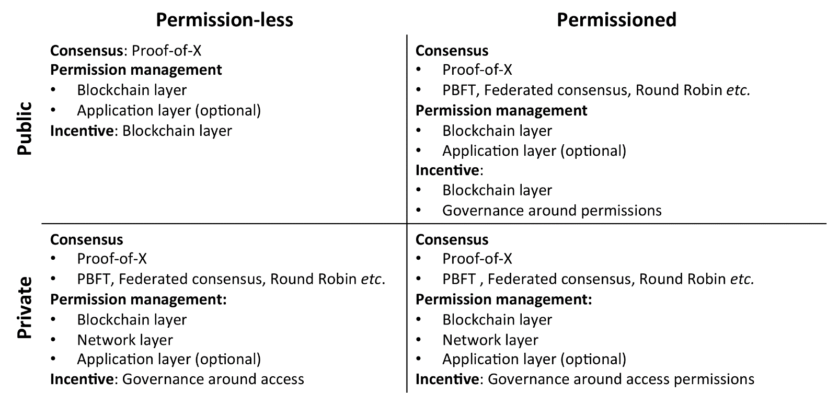
Core components of different types of blockchain

Slide 24
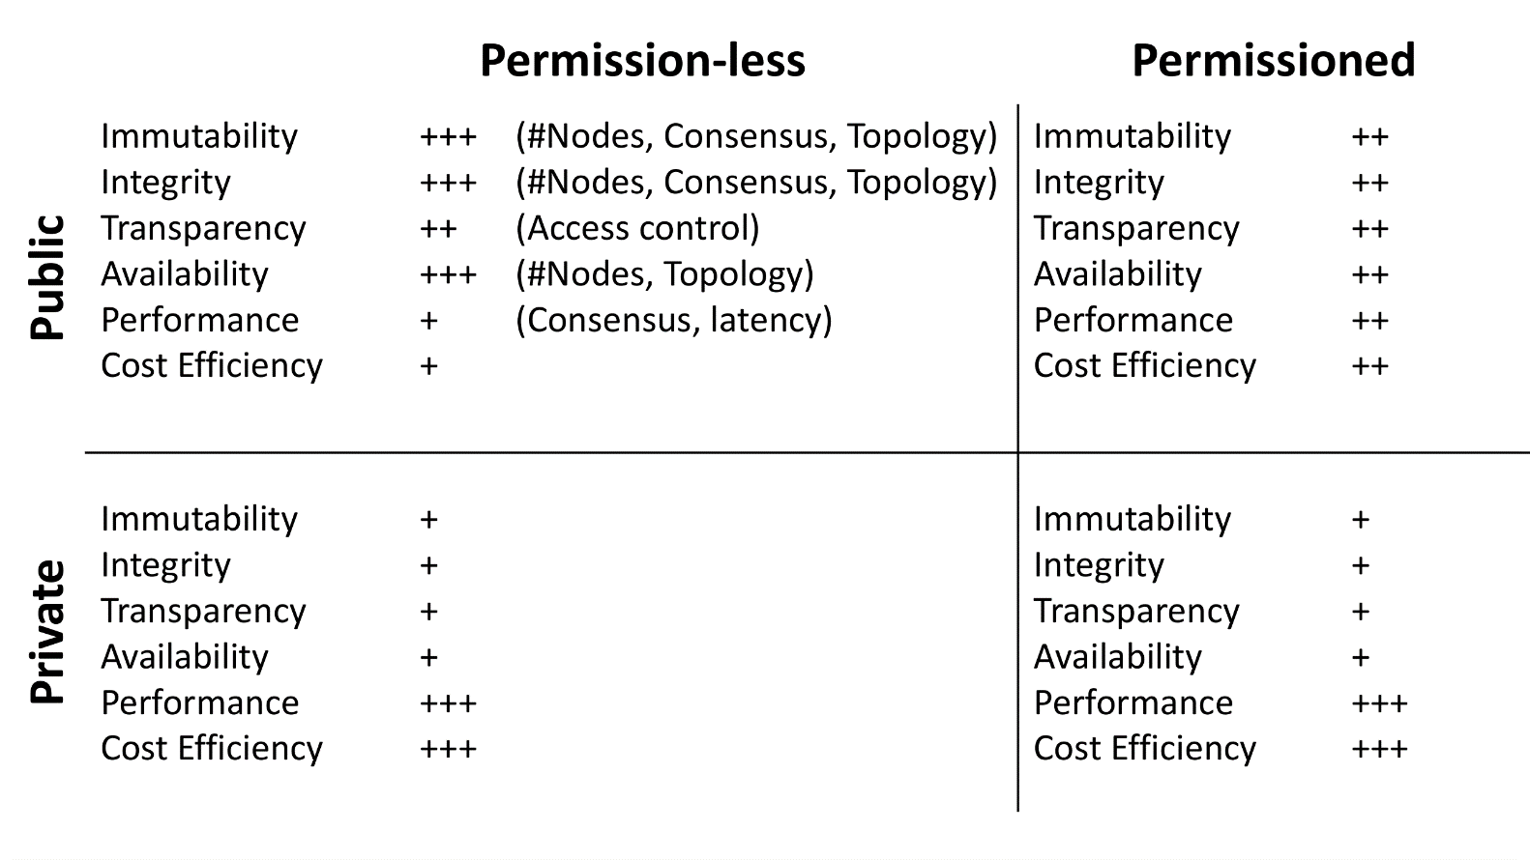
Non-functional properties of different types of blockchain

Slide 25
Student Task
Think of exam registration, and implementing it as a blockchain application (as before)
In breakout groups, take 5 minutes to think about how it could use blockchain functionality
Take 3 minutes to think about non-functional properties: which are the main ones?
Take notes
Then we’ll discuss these

Slide 26
Hyperledger, Overview (cont’d)
Source of most materials:
Xiwei Xu, Ingo Weber, and Mark Staples. Architecture for Blockchain Applications. Springer, 2019

